Slide 1

Professional Implementation Guide
The Multi-Angle
Growth Engine
Dominating the Moroccan Executive
Longevity Market
International Neurofeedback Center
Target Markets
90-Day Strategic Rollout Plan
Casablanca • Marrakech • Tanger • Kenitra

Slide 2
Strategic Framework
Implementation Roadmap
Market
Opportunity
Multi-Angle
Execution
01
02
Ecosystem &
Impact
03
The MENA longevity market gap analysis
Phase 1: Profit-First Setup (Days 1-7)
Full ecosystem architecture
Redefining the target demographic
Phase 2: Marketing Execution (Days 8-45)
Financial impact & unit economics
Strategic positioning for maximum LTV
Phase 3: Automated Triage (Days 46-90)
90-day deployment roadmap
Goal: Shift acquisition from external referrals (30% cost) to owned digital Hub & Spoke SEO and AI funnels (15% cost), improving net margins by 10+ points

Slide 3
CHAPTER 01
Market Opportunity &
Strategic Positioning
Understanding the MENA longevity market gap and repositioning for maximum lifetime value
Market Analysis
Target Demographics
Strategic Positioning

Slide 4
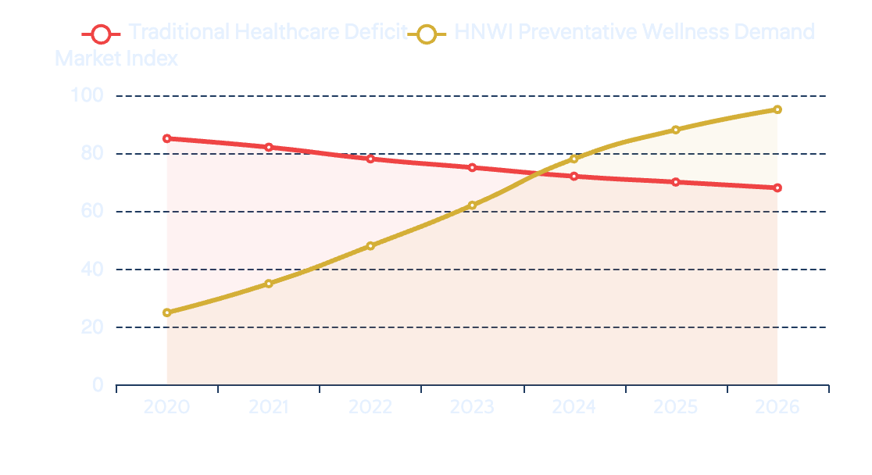
Market Opportunity
The MENA Longevity Land Grab
Market Opportunity Index
The Deficit
Traditional Healthcare Deficit vs. HNWI Wellness Demand
17%
of Moroccans suffer from severe stress/mental health issues
343
psychiatrists for 37M people (<1 per 100,000)
The Shift
MENA wealth shifting from luxury goods to
preventative longevity
Active pursuit: 87% NA HNWIs | 100% APAC HNWIs
The Biohacking Opportunity Zone: Where deficit meets demand
Addressable Market
Service Gap
HNWI Growth
6.3M People
99.7% Unmet
+24% YoY

Slide 5
Strategic Positioning
Redefining the Target Demographic for Maximum LTV
Traditional Mental Health Patient
The Executive Biohacker
Current Positioning
Future Positioning
Primary Motivator
Primary Motivator
Symptom relief (Anxiety, Insomnia, ADHD)
Peak cognitive performance, reaction time, burnout prevention
Price Sensitivity
Price Sensitivity
High - Compares against standard therapy rates
Low - Views brain training as ROI-generating investment
Service Delivery
Service Delivery
A-la-carte, transactional $160 sessions
Concierge annual retainers & comprehensive diagnostic packages
Acquisition Channel
Acquisition Channel
Word-of-mouth and localized Near Me search
B2B Corporate Outreach and targeted LinkedIn HR funnels
LTV: Low | Churn Risk: High | Margin: 15-20%
LTV: 2.18x Higher | Retention: 80%+ | Margin: 25-30%
Strategic Insight
Revenue per Client
By pivoting from transactional to concierge model, we increase average transaction value by 2.18x and improve client retention to 80%+
$3,500+

Slide 6

CHAPTER 02
The Multi-Angle
Growth Engine
Three-phase implementation: Profit-First Setup, Multi-Channel Execution, and Automated Triage
Days 1-7: Foundation
Days 8-45: Execution
Days 46-90: Automation

Slide 7
Phase 1 • Days 1-7
The "Profit-First" Setup
Maximize existing assets and technical tracking to ensure zero wasted ad spend
01
CRM Mining & Win-Back
02
Local SEO & Google Business
03
The Tech Stack
Day 1 • Zero Ad Spend
Day 2 • Foundation
Day 3 • Tracking
Action
Action
Installation
Filter database for "Inactive" patients (6+ months without visit)
Audit NAP consistency (Name, Address, Phone) for Casablanca and Marrakech centers
Install Meta Pixel and Google Analytics 4 tracking on all landing pages
Technique
Optimization
Compliance
Send personalized WhatsApp "Health Checkup" offer with exclusive return discount
Add "Longevity" and "Biohacking" keywords to Google Business descriptions and posts
Configure CNDP Law 09-08 compliant data storage for all incoming leads
Expected Result
Local Strategy
CRM Setup
Immediate cash flow with zero ad spend
Create location-specific landing pages for each city with localized content
Establish lead scoring system and automated tagging based on source and intent
Target: 15-25% reactivation rate
Goal: Dominate "Near Me" searches
Result: 100% attribution tracking
Phase 1 Completion Criteria
Immediate Revenue
All tracking pixels firing correctly • NAP consistency 100% • Win-Back campaign launched • CNDP compliance verified
50-100K MAD

Slide 8
Phase 2 • Days 8-45
Multi-Angle Marketing Execution
Reach different segments where they live online with tailored creative assets
Meta
LinkedIn
Google Search
The Persona Hook
The B2B High-Ticket Play
The "Near Me" Intent
Target
Target
Target Keywords
Parents (ADHD/Focus) and High-Stress Professionals in Casablanca & Marrakech
HR Directors and CEOs in Casablanca/Tanger corporate hubs
"Neurofeedback Casablanca", "ADHD center Marrakech", "how to focus better without meds"
Creative
Positioning
Technique
UGC-style videos (real people, mobile-shot) or static images with clear text overlays
"Executive Brain Resilience" program for burnout prevention and peak performance
Use Broad Match paired with Smart Bidding to capture conversational intent
Script
Outreach Script
Landing Page
"Casablanca founders: Your brain is your highest-yielding asset. Are you protecting it? Neurofeedback isn't therapy; it's a 15-minute upgrade to your cognitive ROI."
"Hi [Name], I noticed [Company] is scaling rapidly. We've been helping Moroccan executives maintain peak focus using measurable qEEG brain mapping. Open to a brief regarding an 'Executive Longevity' pilot?"
Start with 1-2 sentence direct answer to build immediate trust, then CTA for free consultation
CTA: Free Brain Resilience Bilan
Package: Corporate Retainers
Focus: High-Intent Capture
Meta Budget
LinkedIn Budget
Google Budget
5-8K MAD/mo
3-5K MAD/mo
4-6K MAD/mo

Slide 9
Phase 3 • Days 46-90
The Automated "Triage" System
Use AI to qualify leads 24/7, reducing manual administrative work
The AI Funnel Workflow
Key Metrics to Track
1
Trigger: User Clicks Meta Ad
Cost Per Lead (CPL)
<80 MAD
Ad directs to WhatsApp DM instead of landing page
High-volume "Top of Funnel" interest metric
2
WhatsApp AI: Instant Qualification
Utilization Rate
80%+
"Age? City? Main Goal (Focus/Stress/Sleep)?"
Move from "Breakeven" to "Pure Profit Zone"
Lifetime Value (LTV)
2.18x
3
AI Output: Auto-Tag & Route
AI tags lead in CRM and provides booking link for local center
Achieved by front-loading the $350 qEEG diagnostic
4
Result: Qualified Lead Booked
Margin Impact
Lead receives confirmation and pre-session instructions
30%
Current Referral Cost
Digital Hub & Spoke Cost
15%
Optimization Logic: If CPL is low but show-ups are low, adjust AI script to be more selective in qualification
+10 pts
Net Margin Improvement

Slide 10
System Integration
The Full Ecosystem Architecture
4-Stage automated ecosystem with CNDP Law 09-08 compliant data protection
01
Traffic
02
Triage
03
Conversion
04
Retention
Acquisition
Qualification
Revenue
Long-term Value
SEO & Local Maps
WhatsApp AI Chatbot
Discovery Bilan
CRM Nurture
Organic + Google Business
Instant response 24/7
Free 15-min consultation
Automated follow-ups
Google Search Ads
Quiz Qualification
QEEG Brain Mapping
Review Requests
High-intent capture
3-question assessment
$350 high-ticket
5-star reputation build
Meta Persona Ads
Auto-CRM Tagging
Standard Sessions
6-Month Win-Back
Persona-driven demand
Lead scoring + routing
$160 per session
Reactivation loop
Goal: Multi-channel reach
Goal: Zero manual work
Goal: 2.18x LTV increase
Goal: 80%+ retention
CNDP Law 09-08 Compliant
Data Encryption
Consent Management
All sensitive health-adjacent data is legally protected throughout the entire ecosystem
AES-256
GDPR+

Slide 11
Financial Performance
Financial Impact & Unit Economics
Four strategic levers for margin expansion and profitability
Eliminating Referral Waste
Margin Expansion
Reduce external referral commissions from 30% to <15% by building direct-to-consumer Meta/WhatsApp pipeline
Push operating margins from 15% baseline toward 25-30% target via AI administrative efficiency
Annual Savings (per 100 clients)
450K MAD
Margin Improvement
+10-15 pts
Front-End Strategy
Breakeven Velocity
Take slight margin loss on initial low-cost Discovery Bilan to secure highly profitable 10-20 session care plan maximizing LTV
Target 1-month breakeven on unit level based on high contribution margins and optimized acquisition costs
LTV Increase
2.18x
Time to Profitability
30 Days
Path to 30% EBITDA
12-Month Target
By shifting acquisition from external referrals to owned digital Hub & Spoke SEO and AI funnels
30% EBITDA

Slide 12
Implementation Timeline
The 90-Day Deployment Roadmap
01
Foundation
02
Automation & Testing
03
Scale & Expansion
Days 1-30
Days 30-60
Days 60-90
Install Tracking Pixels
Deploy WhatsApp AI Quiz
Optimize Based on Data
Meta Pixel + Google Analytics 4 on all landing pages
CNDP-compliant automated qualification system
Refine CPL, creative, and audience targeting
Optimize Local SEO
Launch Test Campaigns
Roll Out B2B Packages
NAP consistency, Google Business, location pages
First Meta/Google campaigns in Casablanca & Marrakech
High-ticket Executive Peak Performance corporate retainers
Launch Win-Back Campaign
Zero-budget CRM reactivation via WhatsApp
Allocate Test Budget
Expand to New Markets
5,000-8,000 MAD per city for initial testing
Scale successful funnels to Tanger & Kenitra
Revenue: 50-100K MAD immediate
Target CPL: <80 MAD
Target: 30% EBITDA margin
The Multi-Angle Growth Engine
Target Markets
By shifting acquisition from external referrals (30% cost) to owned digital Hub & Spoke SEO and AI funnels (15% cost), you will instantly improve net margins by 10+ points
Casablanca • Marrakech
Tanger • Kenitra

